Slide 1
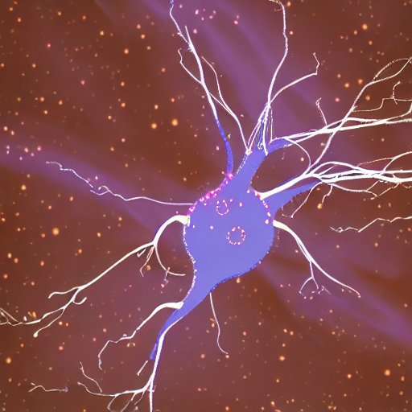
Brain Information Flow under a Sensorimotor Task
AI generated: choose one of them (or none)
By: Manu Ledesma, Zsombor Szasbό, Valantis Andreas
Pod name: Xiaosaurus Boler Group name: Cosmic Neuron

Slide 2
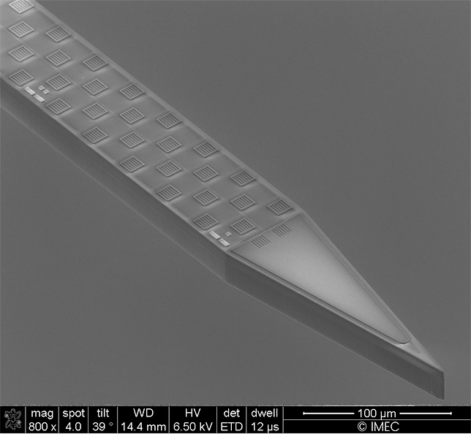
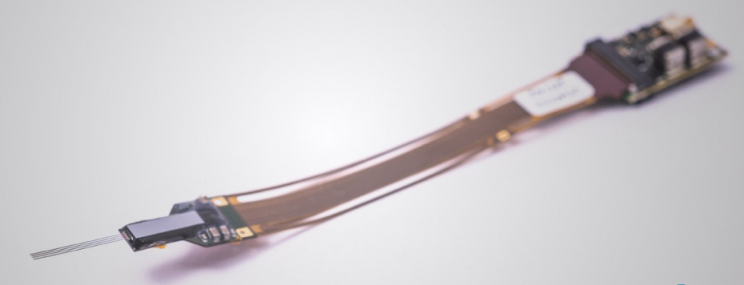

Introduction
Steinmetz dataset (spike trains from >20000 mouse neurons under
grating stimulus task; 10 mice previously trained).
First 500ms ⟹ Baseline activity or chance level
From Stimulus (t=500ms) ⟹ Sequential activation of brain areas
Our Question:
Can we obtain the information flow through different brain areas involved in the visual discrimination task by decoding the specific inputs?

Slide 3
Methods
Build a decoder (spikes rebinned in 50ms, for every available brain area)
Inputs were the feedback type and the response of the mouse
Establish accuracies in said 50ms windows using a logistic regression model
Plot and compare the output accuracies across brain regions
Extract the coefficients of our model and plot them using a heat map
Hopefully get an insight on the decodability of information from the neural population activity through the accuracy of our decoder.

Slide 4
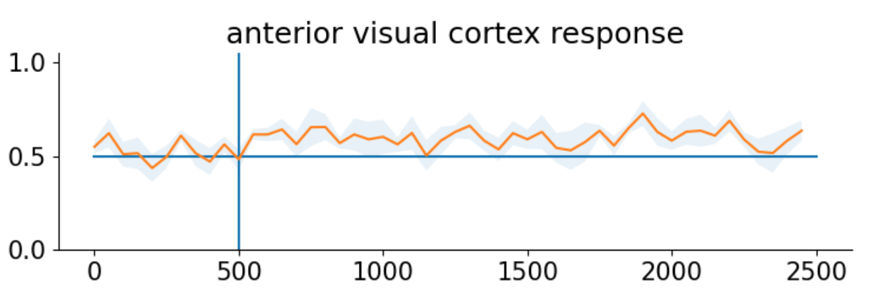
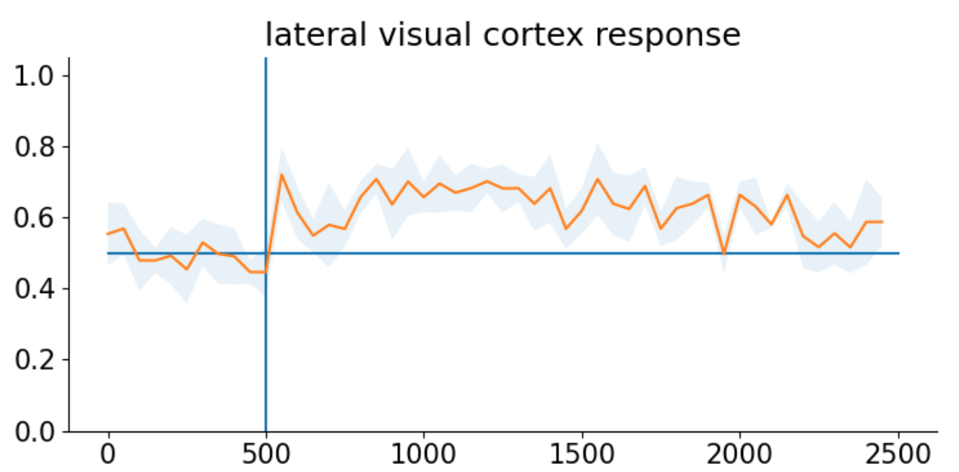
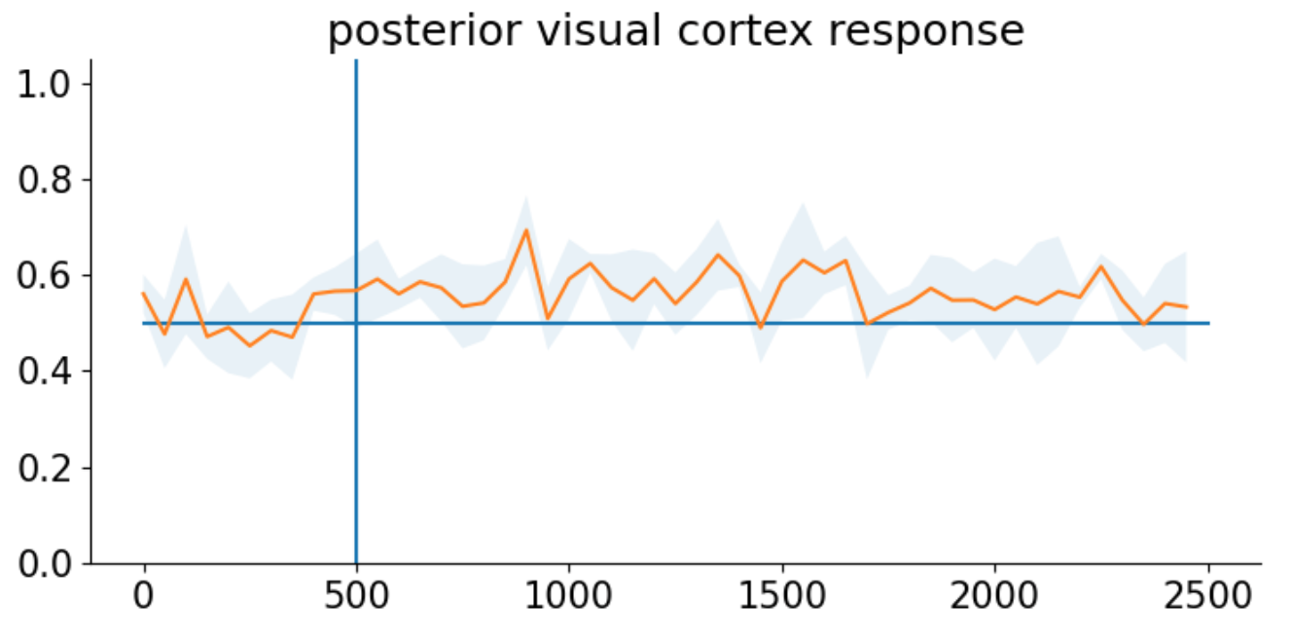
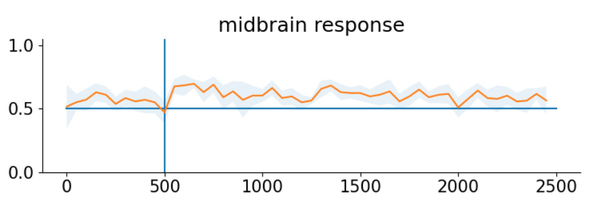
Results
Strong increase in accuracy at stimulus onset for anterior and lateral visual cortex, as well as midbrain
But not on posterior visual cortex!
Horizontal axis is time (ms, up to 2500; vertical line marks stimulus onset). Vertical axis is accuracy (0 to 1) of the decoder.

Slide 5
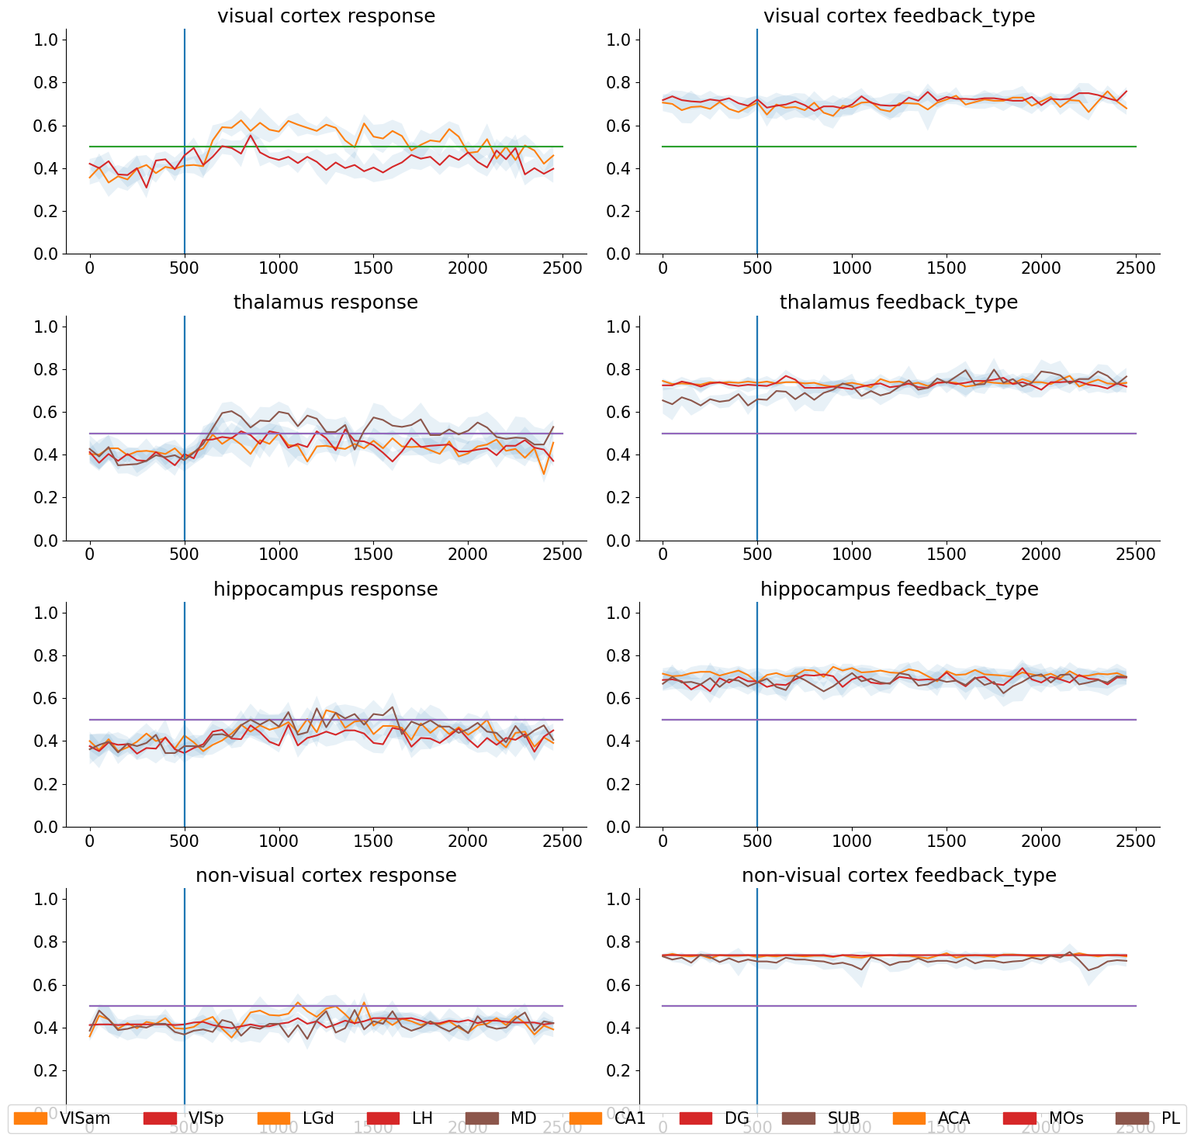
Results
As the stimulus is onset, we can appreciate an increase of the accuracy of our model in the visual cortex and hippocampus brain regions, in accordance with previous studies.
Other brain regions do not show such increase (eg: non-visual cortex)
Feedback type plots don’t show valuable info: model is not suitable for these
Horizontal axis is time (ms, up to 2500; vertical line marks stimulus onset). Vertical axis is accuracy (0 to 1) of the decoder.

Slide 6
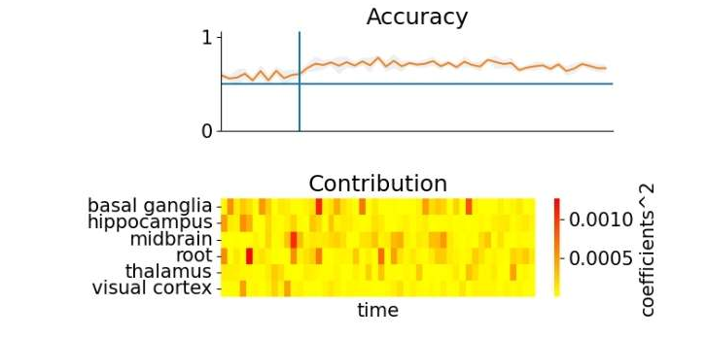
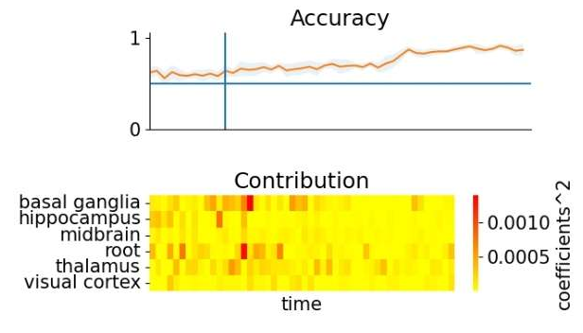
Results
Interpretation of the coefficients significance over time:
Heatmap shows approximation to brain area contribution over time!
Decision
Reward

Slide 7
What could we achieve with a few more weeks?
Sequential activation of brain areas (by time to first spike, spike decay, etc):
LGN -> V1 -> LM -> RL -> LP -> AL -> PM -> AM (Siegle et al, 2021)
Creation of a spike model with discernable right/left decisions
Use of model to predict right/left decisions based only on spike data
Try different inputs besides the feedback type and response
Extract which areas are more important for the task by calculating and comparing the coefficients of the model

